Slide 1
WEB DEVELOPMENT
Introduction to
Web Development
TODAY
Internet & Web
How websites work
HTML, CSS & JavaScript
Frontend and backend
First HTML page
Lecture 1
Understand the web. Follow a request. Build your first HTML page.
90 minutes
Notes:
Opening: tell students this is a first look at the ideas behind websites. No prior coding experience is expected.

Slide 2
LECTURE 1
What you will learn
01
Explain the Internet and the Web
02
Describe what happens when a page loads
03
Name the main parts of web development
04
Create and open a simple HTML file
The goal is understanding and a first result—not memorizing every technical term.
INTRODUCTION TO WEB DEVELOPMENT
02
Notes:
Set expectations: the detailed networking and advanced tools can wait. The practical outcome is one simple page opened in a browser.

Slide 3
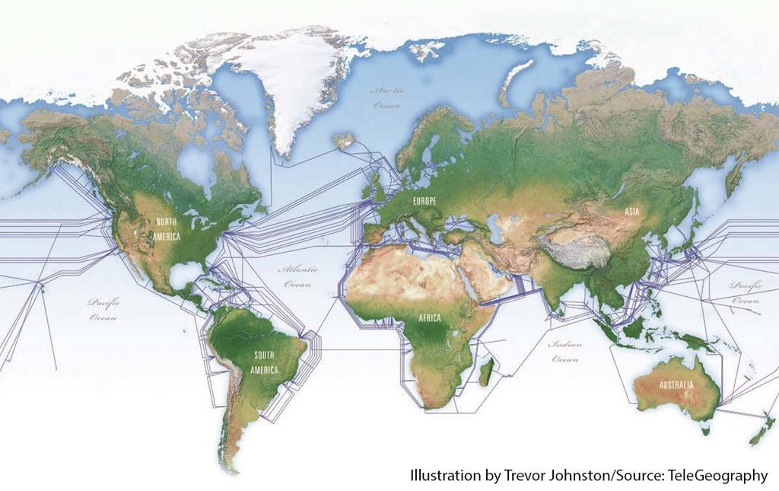
LECTURE 1
The Internet and the Web
INTERNET
WORLD WIDE WEB
A global network that connects computers and other devices.
A system of linked pages and websites accessed over the Internet.
The infrastructure that carries data between devices.
Google, YouTube and online shops are examples.
The Web uses the Internet; the Internet also supports services beyond websites.
INTRODUCTION TO WEB DEVELOPMENT
03
Notes:
Use a simple distinction: the Internet is the connected infrastructure; the Web is one service that runs on it. The map image shows one part of that physical infrastructure: undersea cables.

Slide 4
LECTURE 1
Websites and web applications
Both open in a browser. The difference is mainly what people do there.
WEBSITE
WEB APPLICATION
Presents information
Lets users complete tasks
Read pages, follow links, view information
Sign in, search, save, send or manage data
Examples: a news site, a school information page
Examples: email, online banking, document editor
INTRODUCTION TO WEB DEVELOPMENT
04
Notes:
A website can also be interactive. The categories overlap; use these as a beginner-friendly distinction, not a strict rule.

Slide 5
LECTURE 1
What happens when you open a website?
Example: entering a website address in your browser
YOU
BROWSER
SERVER
BROWSER
Enter an address
→
Sends a request
→
Finds a response
→
Displays the page
The browser and server exchange requests and responses.
INTRODUCTION TO WEB DEVELOPMENT
05
Notes:
Keep the explanation high-level: the browser asks for a resource; the server responds; the browser renders the result. DNS and transport details are taught later.

Slide 6
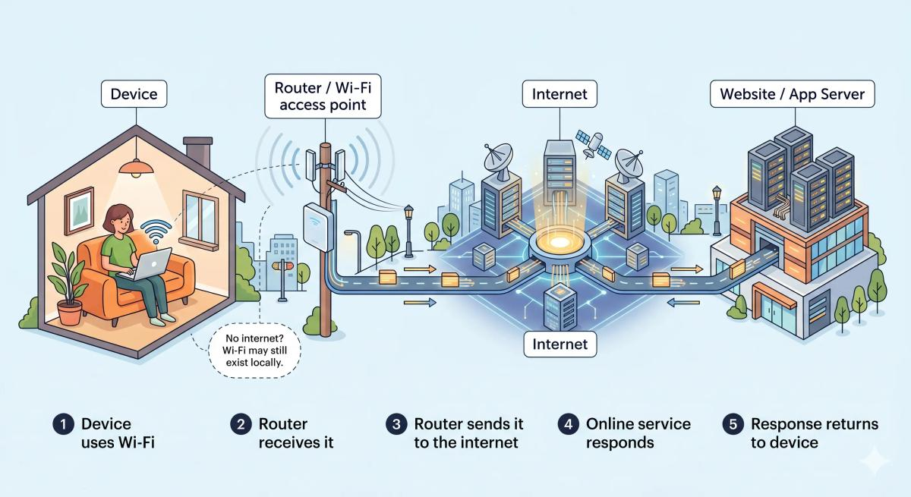
LECTURE 1
How data travels across the Internet
Your device → router → Internet provider and connected networks → website server
INTRODUCTION TO WEB DEVELOPMENT
06
Notes:
The diagram is a simplified model. Explain that a router connects local devices to the network and an ISP provides Internet access. A response travels back to the device.

Slide 7
LECTURE 1
Key terms: browser, server, domain and hosting
Browser
Software that opens and displays websites
Client
The device or software making a request
Server
A computer or program that provides a response
Domain name
A readable address, such as example.com
Hosting
A service that makes a site available online
INTRODUCTION TO WEB DEVELOPMENT
07
Notes:
Clarify that the browser is the client in this example. Domain names are easier for people to remember; hosting stores and serves website files.

Slide 8
LECTURE 1
HTTP and HTTPS
HTTP
HTTPS
A set of rules for communication between a browser and a web server.
HTTP with encryption to help protect the connection.
Look for https:// on secure website connections.
INTRODUCTION TO WEB DEVELOPMENT
08
Notes:
Say that HTTPS encrypts the connection. Avoid promising that HTTPS alone makes a site or its content trustworthy.

Slide 9
LECTURE 1
Three technologies build the frontend
HTML
CSS
JavaScript
STRUCTURE
APPEARANCE
BEHAVIOR
Headings, paragraphs, links, images
Colors, fonts, spacing, layout
Clicks, form checks, changing content
Think of a house: structure, decoration and things that make it work.
INTRODUCTION TO WEB DEVELOPMENT
09
Notes:
Use the house analogy briefly, then point forward: today’s hands-on work is HTML structure. CSS and JavaScript will be introduced in later lessons.

Slide 10
LECTURE 1
Frontend, backend and full-stack
FRONTEND
What users see and interact with
HTML · CSS · JavaScript · Vue.js
BACKEND
Server logic, requests and data
Node.js · Express.js · MongoDB
FULL-STACK
Work across frontend and backend
Both sides of an application
INTRODUCTION TO WEB DEVELOPMENT
10
Notes:
Explain that students will learn both frontend and backend technologies over the course. Do not go into implementation detail here.

Slide 11
LECTURE 1
Tools we will use
VS Code
Chrome
DevTools
Write and organize code
Open and test websites
Inspect and debug a page
Git
GitHub
Track changes to code
Store and share code
INTRODUCTION TO WEB DEVELOPMENT
11
Notes:
Show the Elements panel briefly. Explain that DevTools lets developers inspect how a page is built. Git and GitHub are introduced by name only today.

Slide 12
LECTURE 1
Your first HTML page
<!DOCTYPE html>
<html>
<head>
<title>My First Website</title>
</head>
<body>
<h1>Hello World!</h1>
<p>Welcome to Web Development.</p>
<button>Click Me</button>
</body>
</html>
WHAT THE TAGS DO
<head> Page information
<title> Browser tab title
<body> Visible page content
<h1> Main heading
<p> Paragraph
<button> Button
The button is visible; it needs JavaScript to do something.
INTRODUCTION TO WEB DEVELOPMENT
12
Notes:
Walk through the document from top to bottom. Save index.html, open it in Chrome, change the heading and paragraph, save again, then refresh. The button has no behavior yet.

Slide 13
LECTURE 1
Practice and review
IN CLASS
HOMEWORK
1 Create a folder for the lesson
2 Create index.html in VS Code
3 Type the example and save
4 Open it in Chrome
5 Edit the heading, save and refresh
Install or open VS Code and Chrome.
Create a page with your name, a short introduction and a button labeled “My First Button”. Open it in your browser.
Next: HTML document structure and more HTML elements
INTRODUCTION TO WEB DEVELOPMENT
13
Notes:
Check understanding: internet versus Web; browser versus server; frontend versus backend; roles of HTML, CSS and JavaScript. Homework: make sure the file opens correctly in a browser.

